Slide 1
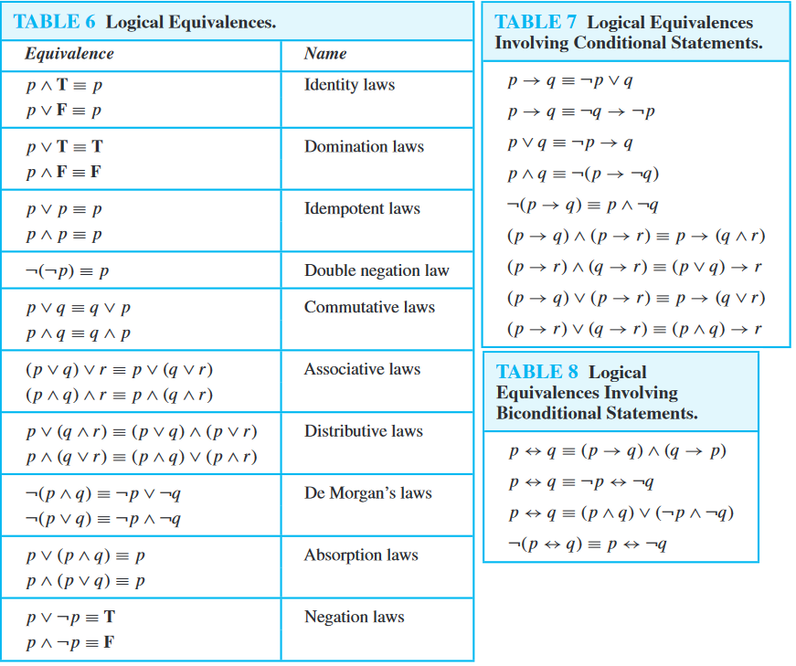
Contrapositive law

Slide 2
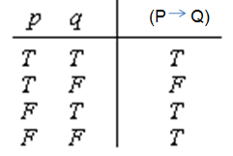
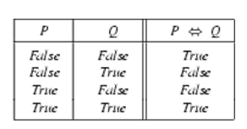
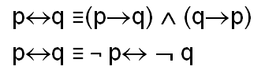
IMPLICATION:
If P is true, P->Q depends on Q
If P is false, P->Q is always true
EQUIVALENCE:
If both P and Q is true, or both P and Q is false then P<->Q is true else false

Slide 3



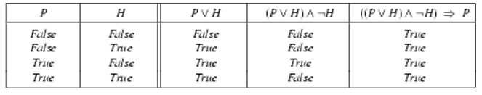
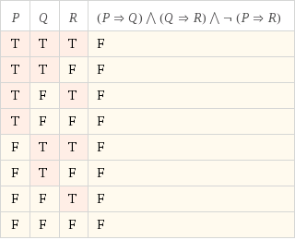
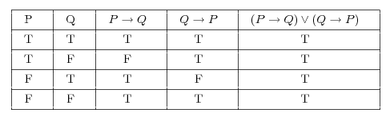
Prove that is a &
is a tautology?
Two expressions are considered tautology(valid) if they are always true under any interpretation. Eg : p V ¬ p
Two expressions are considered contradiction(unsatisfiable) if they are always false under any interpretation. Eg : p ∧ ¬ p
A proposition that is neither a tautology nor a contradiction is called a contingency(satisfiable). Eg : p ∨ p

Slide 4
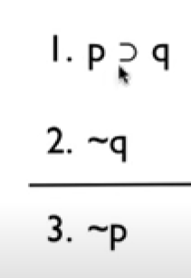
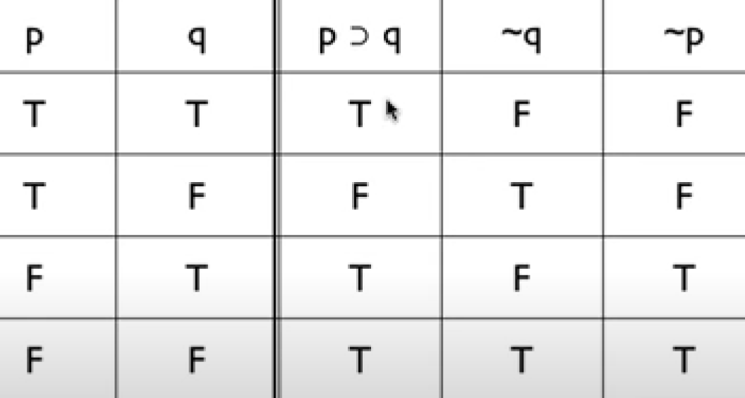
Validity
Premise 1
Premise 2
Conclusion
Select rows where both premise 1 and premise 2 have True. If corresponding conclusion value is True, then it is valid

Slide 5
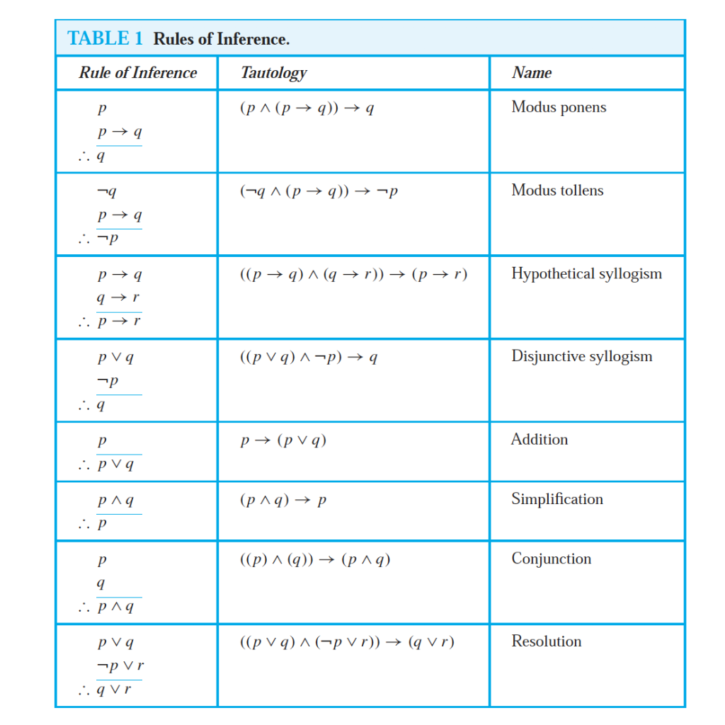

Slide 6
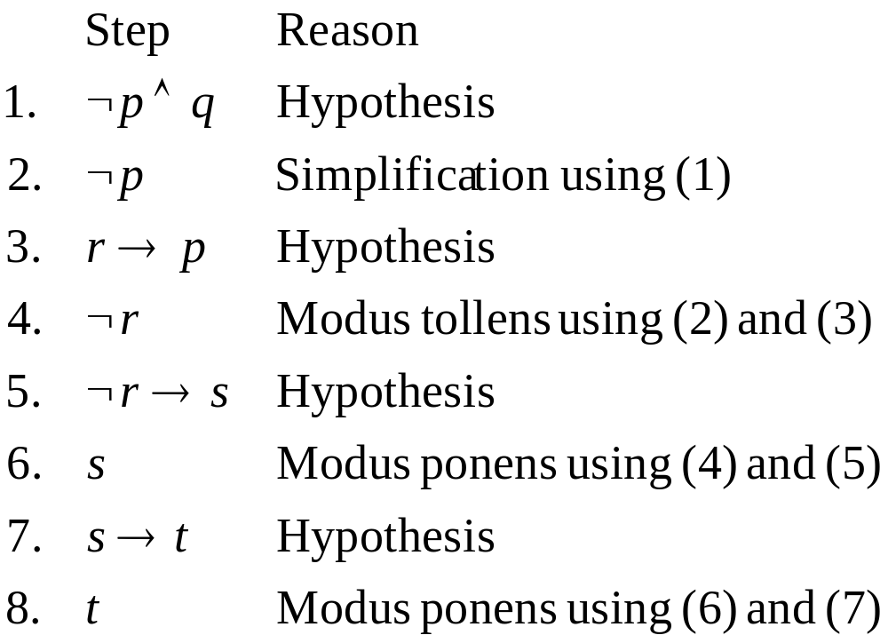
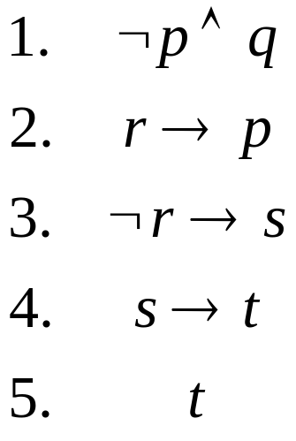
Valid Arguments – Exercise2
“It is not sunny this afternoon and it is colder than yesterday.”
“If we go swimming then it is sunny”
“If we do not go swimming, then we will take a canoe trip.”
“If we take a canoe trip, then we will be home by sunset.”
Using the inference rules, construct a valid argument for the conclusion:
“We will be home by sunset.”

Slide 7
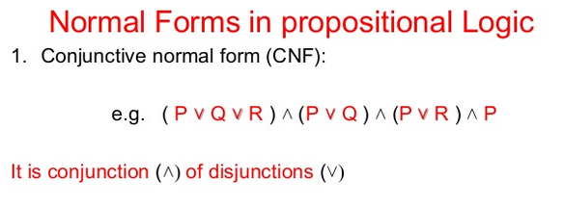
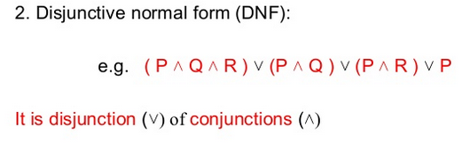

Slide 8
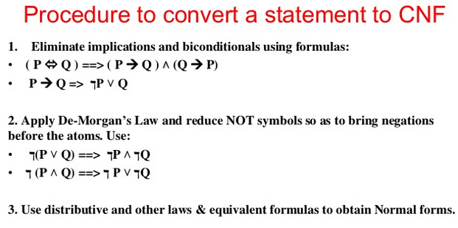
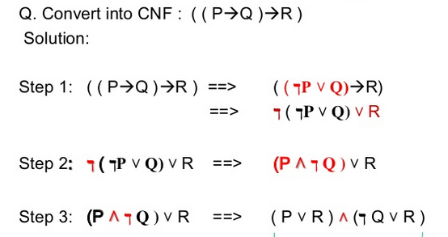

Slide 9
Predicate Calculus - Exercise
Today is wet: Wet(Today)
John likes apples: likes(John, Apples)
It rained on Tuesday: rain(Tuesday)
Ben is a good cat: Good_cat (Ben)
If it does not rain on Monday, Rama will go to the mountains: ¬ Weather (rain, Monday) → go (Rama, mountains)
Mary is a child who takes Coconut-crunchy : Child(Mary) ∧ Takes(Mary, Coconut-crunchy )
All basketball players are tall: ∀x (basketball-players (x) → tall (x))
Some people like chocolates are tall: ∃ x likes ((x, chocolates)^tall(x))
Someone is sleeping : ∃x (P(x) ∧ S(x))
No one is sleeping : ¬∃x (P(x) ∧ S(x))
Everyone is sleeping : ∀x (P(x) → S(x))
Not everyone is sleeping : ¬∀x (P(x) → S(x))
Some girl liked some boy : ∃x ∃y [ (GIRL(x) ∧ BOY(y)) ∧ LIKE(x,y) ]
Every girl liked every boy : ∀x ∀y [ (GIRL(x) ∧ BOY(y)) → LIKE(x,y) ]
Some dragon is sleeping and twitching : ∃x [D(x) ∧ (S(x) ∧ T(x))]
No dragon is sleeping and twitching : ¬∃x [D(x) ∧ (S(x) ∧ T(x))]
Every dragon is sleeping and twitching: ∀x [D(x) → (S(x) ∧ T(x))]
Not every dragon is sleeping and twitching: ¬∀x [D(x) → (S(x) ∧ T(x))]
All saints were Hindus : ∀ x: saints(x) → hindus(x)
All Hindus were either loyal to Ravana or hated him : ∀x: hindus(x) → loyal to (x, Ravana) ∨ hate (x, Ravana)
Everyone is loyal to someone : ∀x: ∃y: loyal to (x, y)

Slide 10
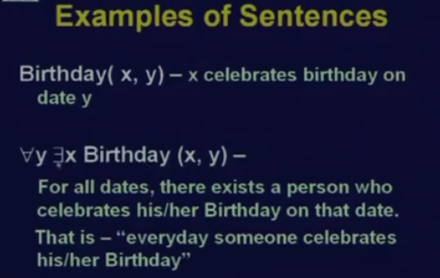
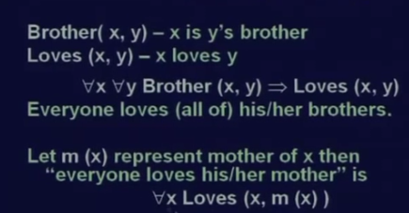
FOPL to sentences

Slide 11
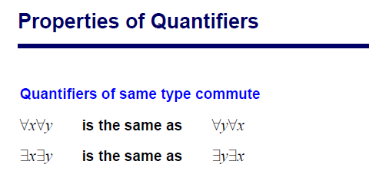
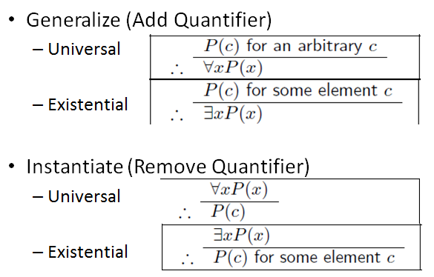
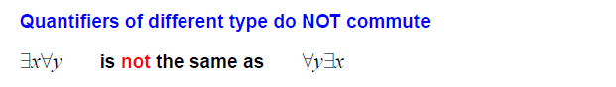
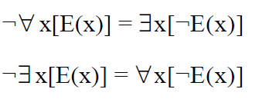
Inference Rules

Slide 12
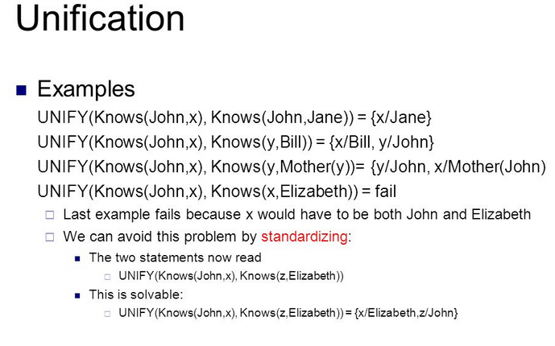
Unification -Unify algorithm takes two sentences and returns a unifier/substitution that makes the two sentences look identical

Slide 13
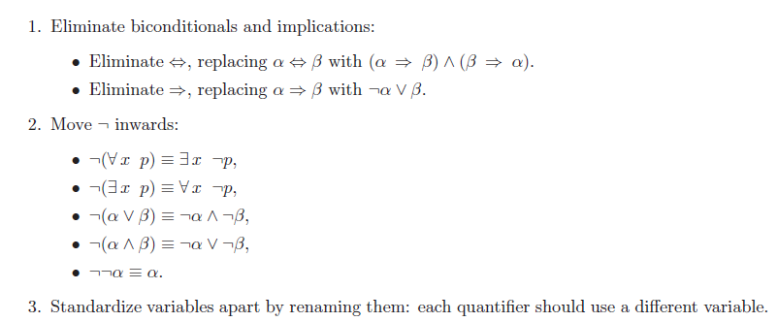
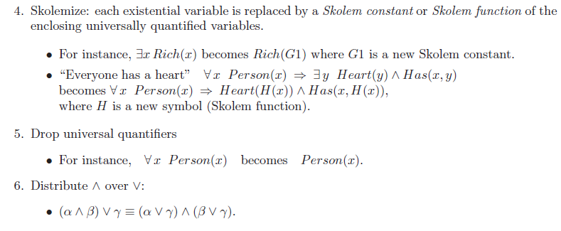
Conversion to CNF

Slide 14
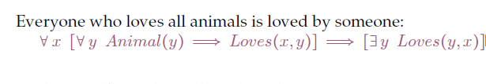
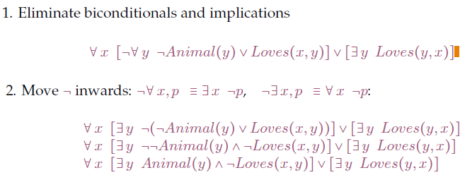
Exercise: Conversion to CNF

Slide 15
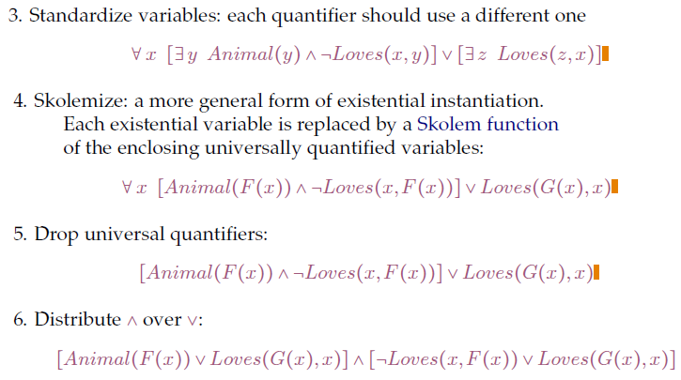

Slide 16
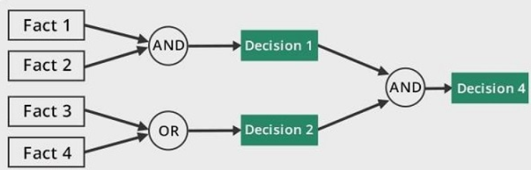
Forward Chaining
In this type of chaining, the inference engine starts by evaluating existing facts, derivations, and conditions before deducing new information. An endpoint (goal) is achieved through the manipulation of knowledge that exists in the knowledge base

Slide 17
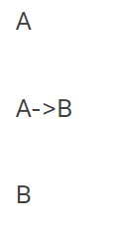
Properties of forward chaining
The process uses a down-up approach (bottom to top).
It starts from an initial state and uses facts to make a conclusion.
This approach is data-driven.
It’s employed in expert systems and production rule system.
A simple example of forward chaining can be explained in the following sequence.
A is the starting point. A->B represents a fact. This fact is used to achieve a decision B.

Slide 18
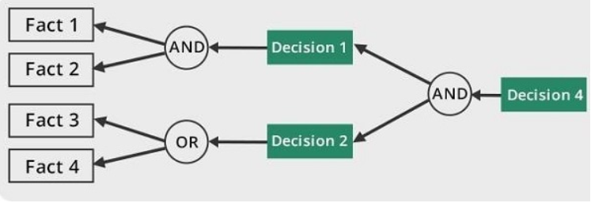
Backward chaining
Backward chaining is a concept in artificial intelligence that involves backtracking from the endpoint or goal to steps that led to the endpoint. This type of chaining starts from the goal and moves backward to comprehend the steps that were taken to attain this goal.

Slide 19
Properties of backward chaining
The process uses an up-down approach (top to bottom).
It’s a goal-driven method of reasoning.
The endpoint (goal) is subdivided into sub-goals to prove the truth of facts.
A backward chaining algorithm is employed in inference engines, game theories, and complex database systems.
The MYCIN expert system is a real life example of how backward chaining works. This is a system that’s used in the diagnosis of bacterial infections.

Slide 20
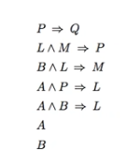
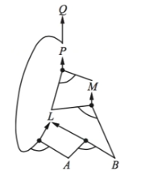
Forward chaining and Backward chaining: Inference Mechanism
Given set of rules in the KB. Apply forward chaining to infer Q

Slide 21
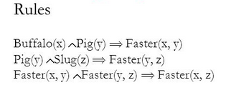

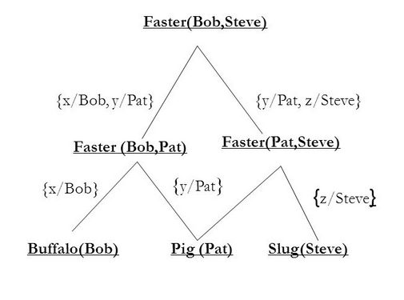
Given sentences:
Facts and Rules in the database
Bob is a buffalo
Pat is a pig
Steve is a slug
Inference by forward chaining: Faster(Bob, Steve)

Slide 22
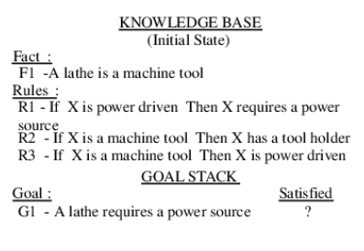
Prove the goal using Forward Chaining

Slide 23
A knowledgebase has the following horn clauses
¬p ∨ ¬q ∨ r
¬r ∨ ¬s ∨ u
¬r ∨ ¬t ∨ ¬u ∨ v
¬q ∨¬t ∨ s
Also, the following facts are present in the KB
F1: p
F2: q
F3: t
Derive the sentence “v” by applying Forward Chaining and Backward Chaining

Slide 24
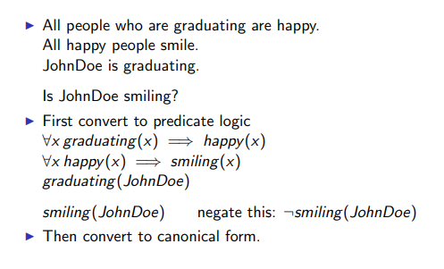
Example 1: Prove by Predicate Logic based Resolution

Slide 25
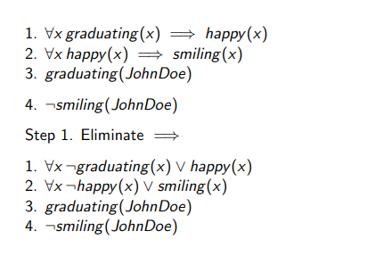
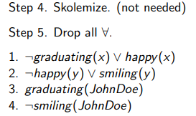
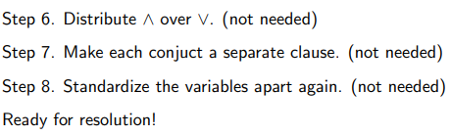
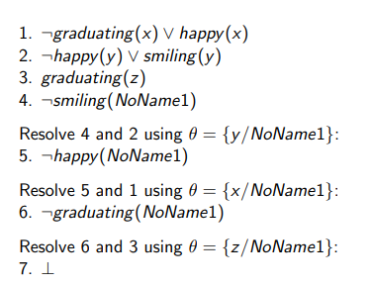
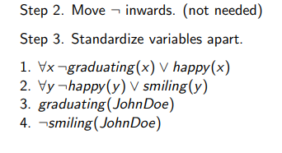

Slide 26
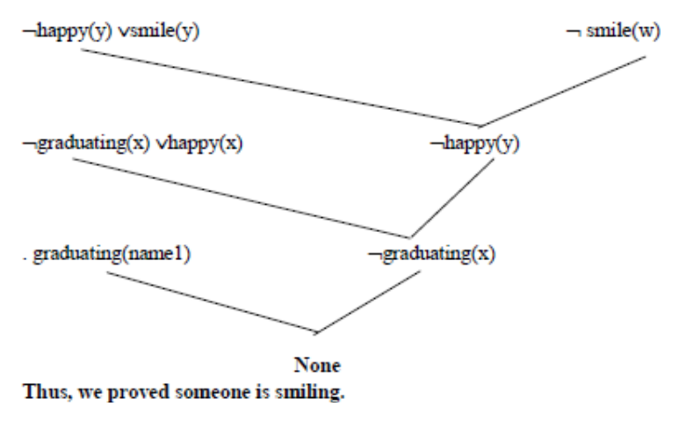

Slide 27
Example 2: Prove by Predicate Logic based Resolution
In English, the problem is as follows:
Everyone who loves all animals is loved by someone.
Anyone who kills an animal is loved by no one.
Jack loves all animals.
Either Jack or Curiosity killed the cat, who is named Tuna.
Did Curiosity kill the cat?

Slide 28
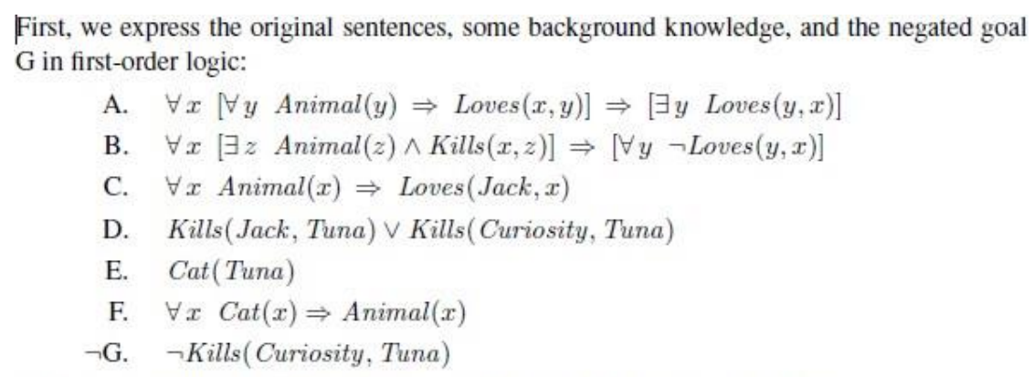

Slide 29
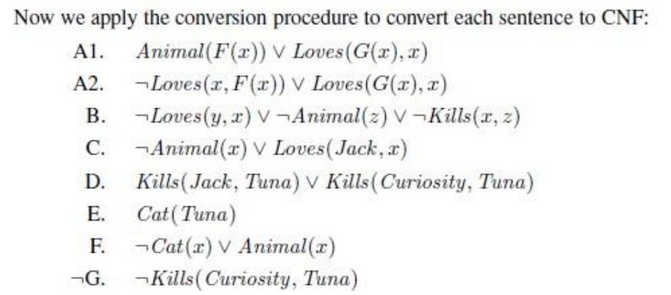

Slide 30
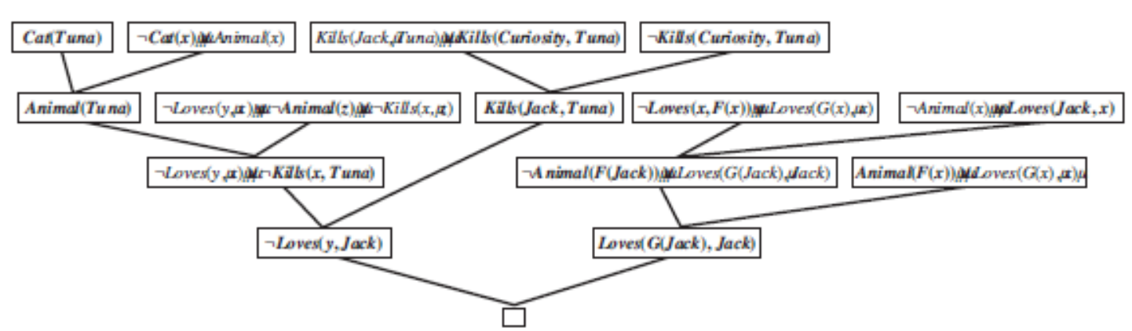
https://youtu.be/-gCIrA5NwT4?si=qmSxhEZhEB0JXbcH

